Slide 1
Design and Architecture
CIDM 6330
Spring 2021

Slide 2
Design and Architecture
Martin Chapter 1

Slide 3
Design
Decisions and Choices
“The goal of software architecture is to minimize the human resources required to build and maintain the required system.”
Also: satisfy the intensions of the stakeholders of the system
Intension:
Any property or quality connoted by a word, phrase, or symbol.
The ideas, properties, or corresponding signs that are implied or suggested by the concept in question
Extension: All known examples from which a concept can be validated.
Example:
I want a system like Facebook
Facebook is a social medium
I want a social medium (choices determine the actual outcome over time)

Slide 4
Outcomes
Design outcomes
Are not “Free”
Are stochastic
Require a combination of actions of design and development
We, perhaps incorrectly, call these actors “Engineers”
Mythical Man Month – Fred Brooks
Adding more resources has a non-linear and perhaps detrimental impact
Over time, Software Systems become
More difficult to make
Take longer
More expensive
Why?

Slide 5
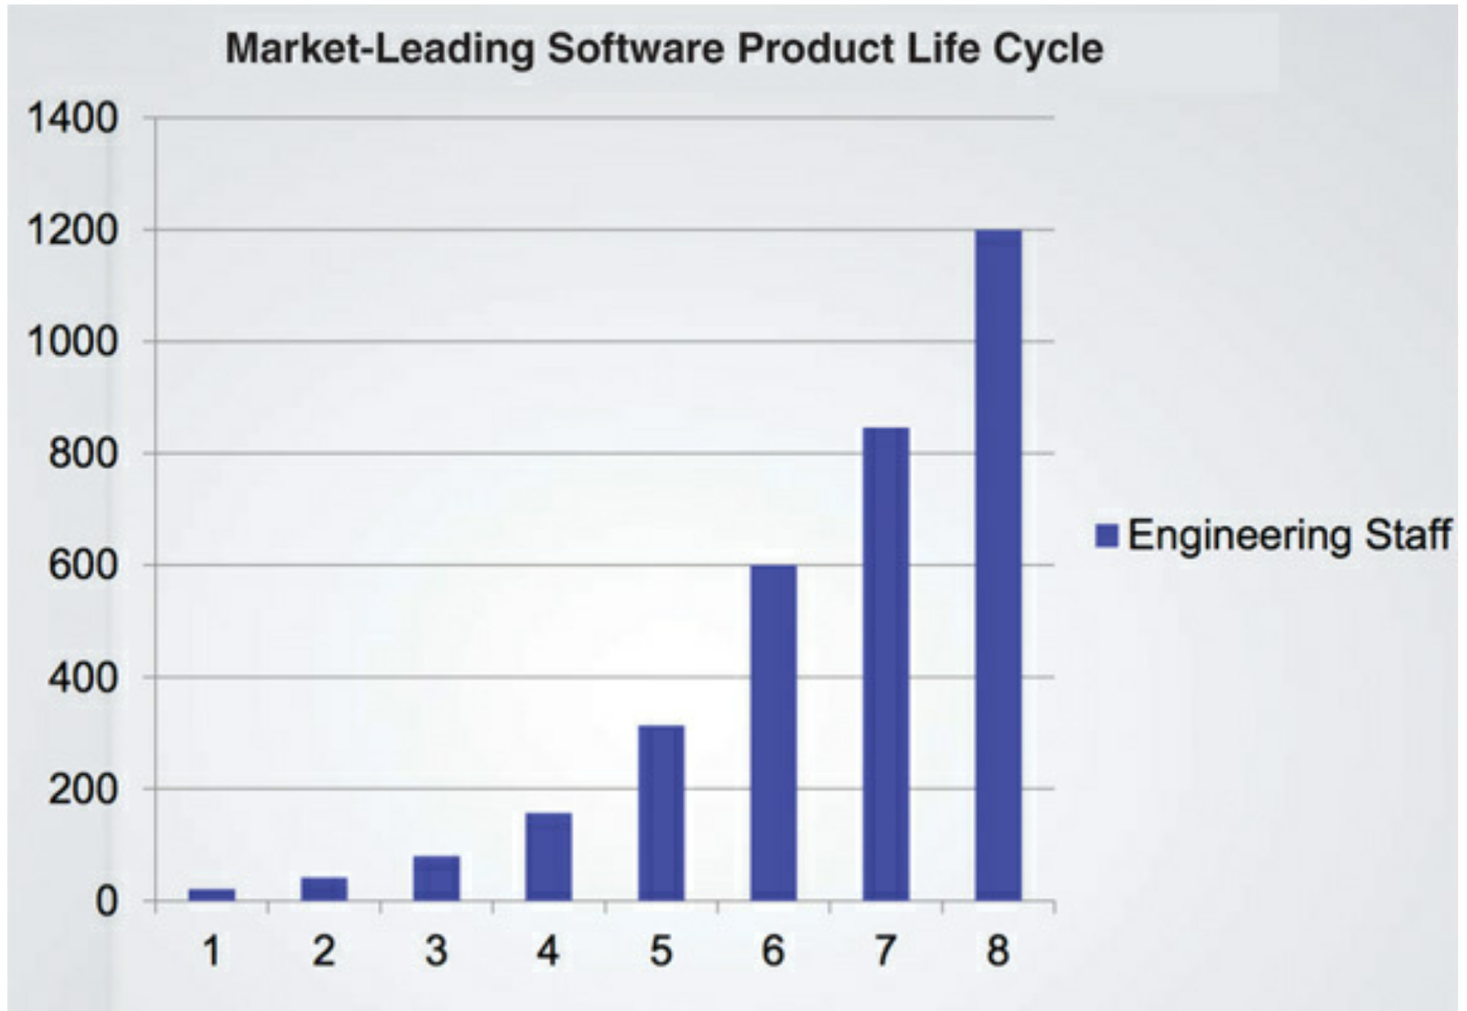
Case – Resources over time
Number of Developers
Working on product iterations over time

Slide 6
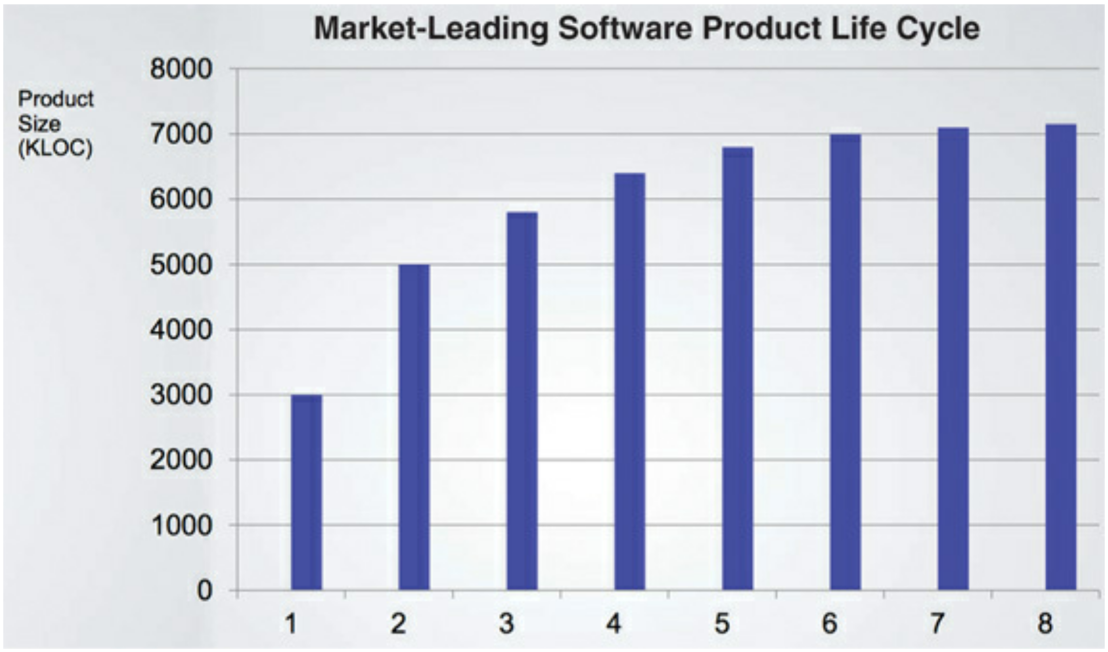
Case – Productivity over time
Productivity of those Developers over time

Slide 7
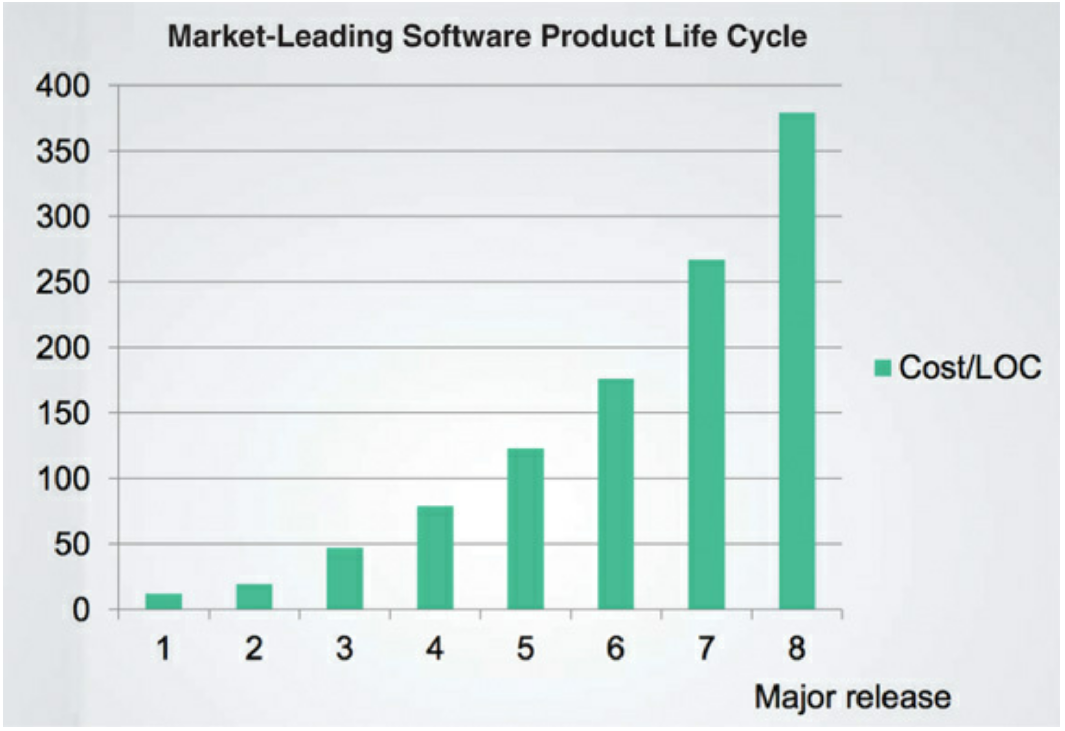
Case – Cost over time
Cost per line of code over time

Slide 8
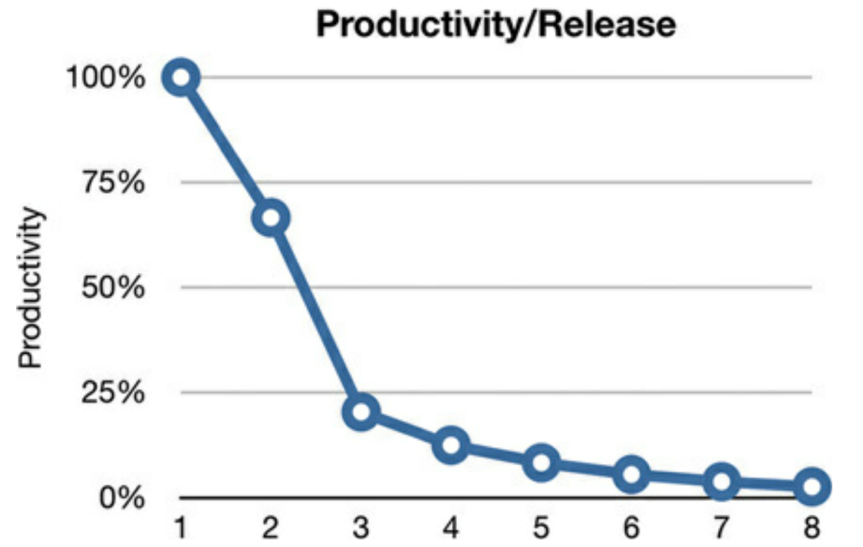
Case - ROI
Return on investment

Slide 9
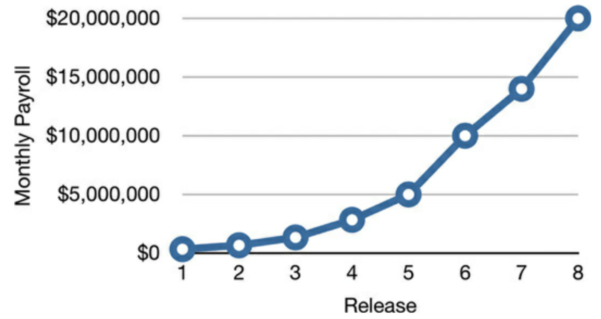
Case – Cost per Release
Expanding costs

Slide 10
A premise
Design matters
Validation and Verification Matter
The system is founded on code (the artifact)
Technical Debt is certain and accrues
Martin: Fast development is prone to messes

Slide 11
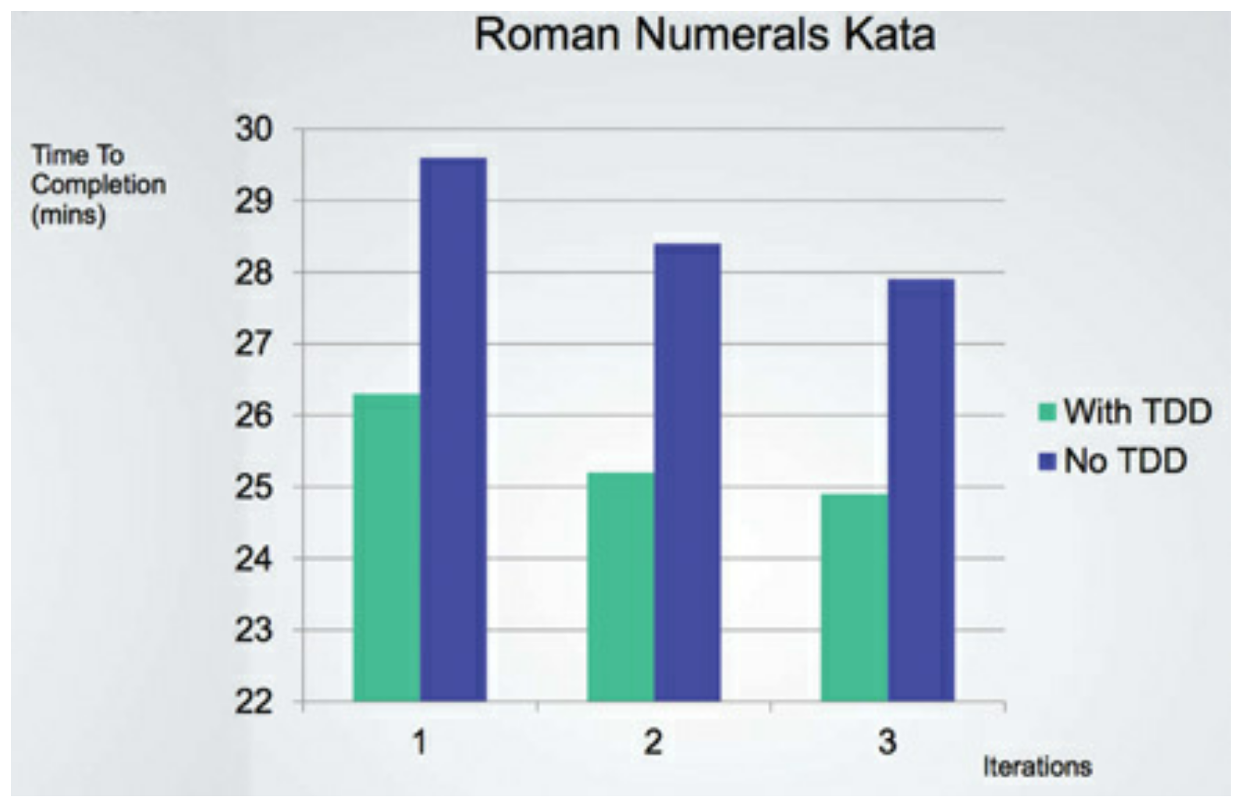
Roman Numerals Kata
https://codingdojo.org/kata/RomanNumerals/

Slide 12
Fast not Best
The only way to go fast, is to go well
Overconfidence will cause repeated failure and mess

Slide 13
Stakeholder Intensions
Martin Chapter 2

Slide 14
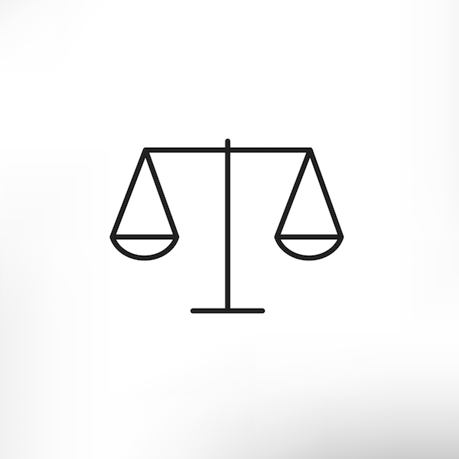
Stakeholder Values
Structure
Behavior
Structure
Behavior

Slide 15
Behavior
Observable effect of inputs, processing, and outputs such that the intensions of stakeholders are realized
Assumes:
Intensions are correct (design specification)
Means/ends primacy
Software
The “soft” assumes that modification to suit is available
Shape – what behaviors should be changed
Scope – the breadth of impact of the changes
Choices
All of these call for design choices

Slide 16
Structure
Architecture is the design and implementation to ensure behavior
Snowball of Implementation
The sum of Shaping and response to change
The primacy of behavior
I don’t care how it works, I want it to work (and cheaply)
The imperative for design
Designing the system to accommodate change

Slide 17
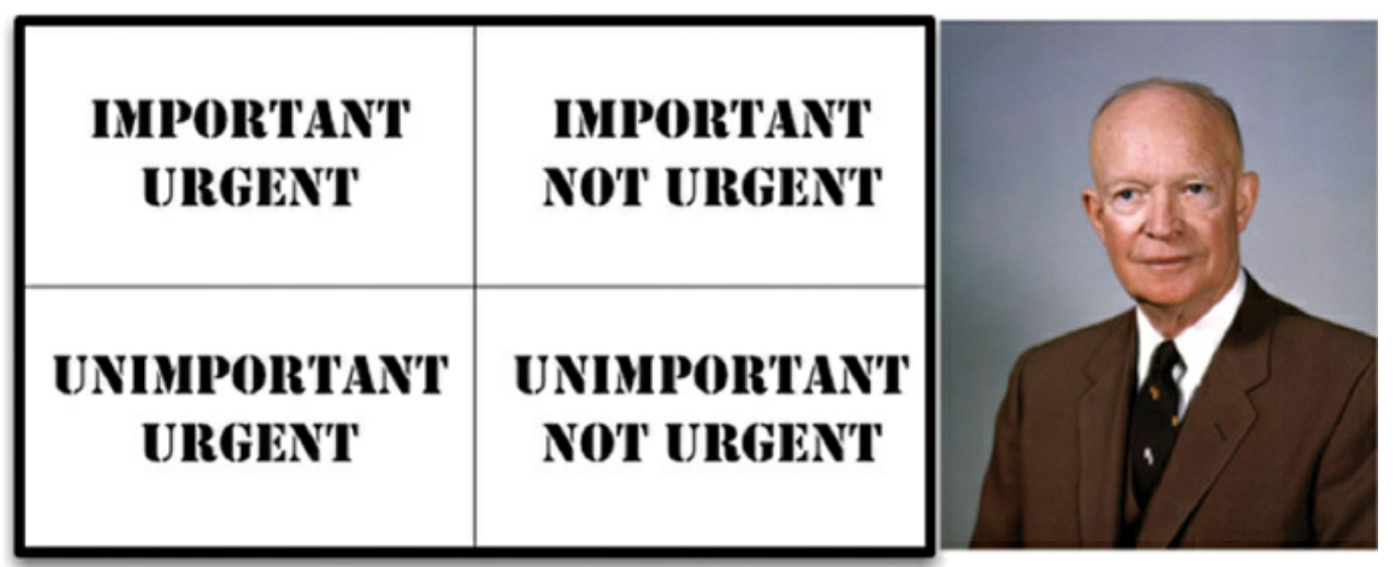
Change vs Structure
“I have two kinds of problems, the urgent and the important. The urgent are not important, and the important are never urgent.”

Slide 18
Balance
The first value of software—behavior—is urgent but not always particularly important.
The second value of software—architecture—is important but never particularly urgent.

Slide 19
Design and Architecture are Not Assured
The “give me the behavior now” is always stronger as it is connected to the will to render resources
Clean and well-designed architecture is a professional imperative for the system designers and developers
This all gets worse as the system grows in success

